Slide 1


DSC FINANCE AND DIGITAL INNOVATION HACKATHON
Suspicious Transaction Detection
in Mobile Money
Sol Plaatje University Data Science Club, in partnership with Standard Bank
GROUP 8 · THE STANDARD DEVIANTS
636 262
Ovayo Jack
202101500
Aphelele Gwebityala
202430482
mobile-money transactions analysed
Thuthukani Nhlengethwa
202316164
Thuto Matlolokwe
202302808
849
Bulumko Teta
202402810
fraud cases — 0,13% of all activity
Notes:
Introduce the team and the brief. One line: we were asked to detect suspicious transactions in a mobile-money log of 636 262 records containing 849 frauds.

Slide 2
THE PROBLEM
The challenge is not detection. It is imbalance.
Fraud is 0,13% of activity — one transaction in every 749.
636 262
849
1 in 749
2 of 849
Transactions over ~31 simulated days
Confirmed fraud cases
Prevalence of fraud in the log
Caught by the bank's existing rule (0,24%)
A model that predicts “never fraud” for every transaction is 99,87% accurate — and catches nobody.
That single fact set every decision in this project. We never report accuracy. We report precision-recall, missed fraud, false alarms, and money.
Two errors, two very different price tags
Missed fraud (false negative): the bank absorbs the loss — roughly 1,5 million units per case.
False alarm (false positive): an analyst reviews a good transaction — roughly 150 units of time. The asymmetry is about 10 000 to 1.
Group 8 · The Standard Deviants · Sol Plaatje University × Standard Bank
2
Notes:
Open with 636 262 and 849. Pause on 'two of 849'. Everything we build only has to beat two.

Slide 3
METHOD
Seven stages, each one justified by the stage before it
No step was taken because it is conventional. Each answers a problem the previous step exposed.
1
Exploratory analysis
2
Feature engineering
3
Multicollinearity
4
Feature selection
Find where fraud concentrates before engineering anything.
Balance-error terms and zero-balance flags built from raw columns.
VIF screening, then PCA on the pair that stayed correlated.
Mutual information, because correlation misses threshold rules.
5
Model training
6
Cost evaluation
7
Business rule layer
Test set held out
and never resampled
Five classifiers, undersampled after the split, never before.
Confusion counts converted into money, not just PR-AUC.
A six-rule engine an analyst can read without a model.
127 253 transactions, 170 frauds, left fully imbalanced so results reflect real conditions.
Group 8 · The Standard Deviants · Sol Plaatje University × Standard Bank
3
Notes:
Emphasise step 6 - cost evaluation - as the one most teams skip, and the test-set discipline on the right.

Slide 4
FINDING 01 — WHERE
All of the fraud sits in two of the five channels
Three channels are completely clean across roughly 359 000 transactions.
Fraud rate within each transaction channel
100%
of all fraud is carried by TRANSFER and CASH_OUT alone
4,4×
TRANSFER's fraud rate versus CASH_OUT — on a quarter of the volume
Why this matters
Less than half of all traffic carries every unit of risk. Before a single model is trained, the monitoring problem has been cut in half.
Group 8 · The Standard Deviants · Sol Plaatje University × Standard Bank
4
Notes:
432 frauds in TRANSFER, 417 in CASH_OUT. Zero in PAYMENT, CASH_IN and DEBIT.

Slide 5
FINDING 02 — WHAT IT LOOKS LIKE
Fraud has a fingerprint, and it is visible before authorisation
Three signals, all computable from information known at decision time.
Transaction amount profile — share of each class
The drain signature
98,2%
Fraud (red) versus legitimate (blue). Amounts are simulation currency units.
of fraud moves the sender's entire balance. The account is emptied, not skimmed.
The mule destination
66,2%
of fraud lands in customer accounts holding nothing beforehand, against 13,8% of legitimate traffic.
The size signature
46,1%
of fraud exceeds 500 000 units, against 5,3% of legitimate traffic — a different population, not outliers.
Group 8 · The Standard Deviants · Sol Plaatje University × Standard Bank
5
Notes:
The drain signature showed almost no linear correlation with the target. A correlation heatmap alone would have thrown it away.

Slide 6
FINDING 03 — WHEN
The overnight fraud spike is arithmetic, not behaviour
The most interesting thing in the data is a conclusion we refused to draw.
THE MYTH
WHAT THE COUNTS SAY
“Fraud peaks at 22,7% in the early hours — criminals work at night.”
Fraud arrives at a near-constant 25 to 43 cases per hour, right through the cycle.
This is what a fraud-rate-by-hour chart appears to show, and it is the conclusion the data invites you to reach.
What collapses overnight is legitimate volume — from roughly 64 000 transactions an hour to about 150. Same numerator, tiny denominator.
~35
430×
0
average fraud cases per cycle hour — essentially flat
swing in legitimate volume between the busiest and quietest hour
clock times we can honestly quote — the time column has no stated origin
The operational conclusion is not “staff the night shift”. It is that a fixed alert threshold behaves completely differently in low-traffic windows — any deployed rule has to be volume-aware.
Group 8 · The Standard Deviants · Sol Plaatje University × Standard Bank
6
Notes:
The operational conclusion is not 'staff the night shift'. It is that a fixed alert threshold behaves completely differently in low-traffic windows, so any deployed rule has to be volume-aware.

Slide 7
MODELLING FOUNDATIONS
Redundant features removed, non-linear signal recovered
Correlation alone would have discarded the single strongest predictor in the dataset.
1
Multicollinearity screened
2
Correlated pair merged
3
Selection by mutual information
VIF 410 → under 3,6
98,5% variance retained
Non-linear signal recovered
The raw balance columns were near-duplicates: newbalanceOrig and oldbalanceOrg scored VIF 410,0 and 409,1. After dropping the redundant pair, every remaining feature fell below 3,6.
amount and errorBalanceOrig correlated at r ≈ 0,97 because amount is algebraically inside the error term. PCA replaced both with one component holding 98,5% of their shared variance.
Every engineered feature showed weak linear correlation with fraud, because fraud here follows threshold and interaction rules. Mutual information scored those correctly; Pearson could not.
The limitation we raise before anyone asks
The balance-error features are almost perfectly clean separators of fraud in this data — median error of exactly zero for fraud. That sharpness is a property of a simulator, not of a real ledger, where legitimate transactions also carry rounding and timing noise. It must be re-validated against live transaction logs before anyone relies on it, and the dashboard deliberately scores transactions using only values knowable before a transaction settles.
Group 8 · The Standard Deviants · Sol Plaatje University × Standard Bank
7
Notes:
Top eight features by mutual information: day, errorBalanceDest, hour_of_day, amount_errBal_PC1, type_TRANSFER, newbalanceOrig, type_PAYMENT, origZeroBefore.

Slide 8
RESULTS
Five models, one untouched test set
127 253 transactions and 170 frauds, left fully imbalanced. Undersampling was applied to training data only.
Approach | ROC-AUC | PR-AUC | Missed fraud | False alarms
XGBoost | 0,990 | 0,594 | 8,8% | 2,9%
Random Forest | 0,988 | 0,568 | 12,9% | 1,8%
Decision Tree | 0,973 | 0,168 | 14,1% | 1,8%
Logistic Regression | 0,943 | 0,075 | 22,4% | 7,6%
Bayesian Logistic Regression | 0,943 | 0,076 | 22,4% | 7,7%
Six-rule business engine | — | — | 0,0% | 69,0%
PR-AUC — the metric that survives extreme imbalance
Both tree ensembles substantially outperformed the linear models — direct confirmation that fraud here follows threshold and interaction rules that a linear decision boundary structurally cannot represent.
ROC-AUC ranks all five models as excellent. PR-AUC separates them by a factor of eight. At 0,13% prevalence, only one of those two metrics is telling the truth.
Group 8 · The Standard Deviants · Sol Plaatje University × Standard Bank
8
Notes:
XGBoost missed 15 of 170 frauds while flagging 2.9% of legitimate traffic. Logistic regression missed 38 and flagged 7.6%.

Slide 9
THE DECISIVE ANALYSIS
Metrics rank one way. Money ranks another.
Expected cost on the test set at 1,5 million units per missed fraud and 150 units per review.
5 600 : 1
break-even cost ratio between a missed fraud and a review
10 000 : 1
the ratio the business actually faces — so recall wins
But capacity is real
The rule engine wins on cost by flagging 87 687 transactions. XGBoost flags 3 734. No fraud desk can staff the first number.
For context: the bank's existing rule would have cost roughly 255 million units on this same test set, because it catches almost nothing.
Group 8 · The Standard Deviants · Sol Plaatje University × Standard Bank
9
Notes:
Break-even: the rule engine buys 15 extra caught frauds for 83 953 extra reviews. That is worth it whenever a missed fraud costs more than about 5 600 reviews - roughly 840 000 units. It does.

Slide 10
RECOMMENDATION
Neither model alone. A cascade that uses both.
Cheap rules for recall, a trained model for ranking, and a human for the decision.
STAGE 1
STAGE 2
STAGE 3
Screen with rules
Rank with XGBoost
Decide with a human
Every TRANSFER and CASH_OUT is scored against six interpretable rules. Catches 100% of test-set fraud. Costs nothing to train and can be explained to a regulator in one sentence.
The flagged queue is ordered by model probability, so the 3 734 highest-risk items surface first. Recall comes from the rules; priority comes from the model.
Analysts work the queue from the top. Nothing is auto-blocked. Every alert arrives with the specific reasons it scored, so a decision takes seconds.
Keep it honest over time
Tune the threshold to the bank's real cost ratio
Fraud is non-stationary. Track the flag rate and the model's score distribution week on week; when either drifts beyond a control limit, retrain and re-tune the threshold rather than waiting for the loss report to tell you.
Every model here used a default 0,5 cut-off. Because the cost of a missed fraud and a review are known quantities, that threshold should be chosen by expected cost, not convention — the single highest-return change still available.
Group 8 · The Standard Deviants · Sol Plaatje University × Standard Bank
10
Notes:
The rule engine and XGBoost are complementary, not competing. Rules give recall and explainability; the model gives triage order and a manageable false-alarm rate.

Slide 11
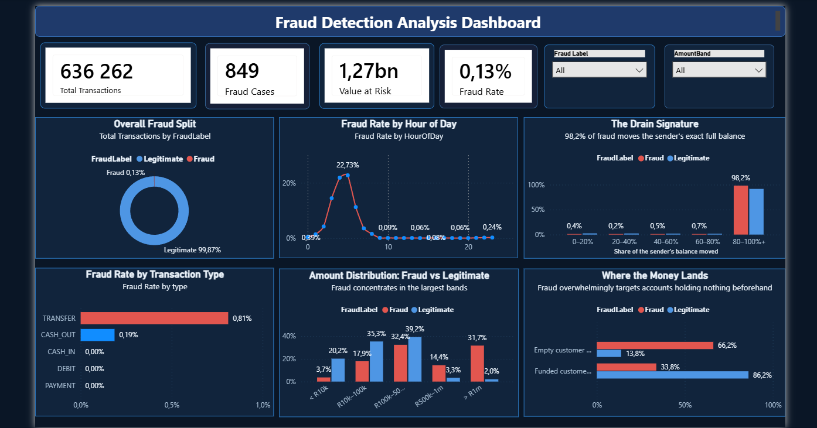
DELIVERABLE
One page, six charts, six different questions
Built in Power BI so a fraud analyst can interrogate the findings without asking for a new report.
Where
Fraud rate by channel isolates the two that matter.
How large
The full amount distribution, not an average.
How much
The drain signature — share of the balance moved.
Where it lands
Destination account state, the blacklistable part.
When
Cycle position, framed as a denominator effect.
Scale
KPI row anchored on 849 frauds and 2 caught today.
Four slicers cross-filter every visual. Amounts are labelled as simulation currency units throughout.
Group 8 · The Standard Deviants · Sol Plaatje University × Standard Bank
11
Notes:
Demonstrate one slicer click - filter to the largest amount band and let every visual move at once. One deliberate click, then clear it.

Slide 12
CLOSING
What we will not claim
Stating the boundary of the evidence is part of the result, not a caveat bolted onto it.
1
Not South African bank data
2
No currency, so no rands
This is a synthetic log calibrated on one month of an African mobile-money service. Every conclusion is about that generating process.
The dataset publishes no currency. Every figure in this deck is a simulation currency unit.
3
No clock times
4
Signal not yet field-tested
The time column counts hours from an unstated origin. We report position in the cycle and never a time of day.
The balance-error separation is unusually clean for synthetic data and must be re-validated on live logs before deployment.
On our use of AI
What we will claim
AI tools were used to troubleshoot unfamiliar techniques and to write boilerplate for confusion-matrix and plotting loops. No suggested code was run unexamined, and every interpretive claim was grounded in printed crosstabs rather than accepted from a model's phrasing. The analytical decisions were made and verified against the data.
Two channels, one balance test, one destination test. Three columns and no machine learning separate these classes almost completely — and a trained model on top turns that into a queue a fraud desk can actually work.
The rule running on this data today catches 2 frauds out of 849.
Group 8 · The Standard Deviants · Sol Plaatje University × Standard Bank
12
Notes:
Close on the limits, then the single sentence about two out of 849. Thank the panel and open for questions.

